Slide 1

WordMasters Basics: 10 Easy Steps

Slide 2

WordMasters Basics
You have tremendous flexibility in how you build your team and incorporate it into your school setting.
Some teams have the whole class participate while other teams are comprised of interested students or those in an accelerated language arts program. Others offer it as after school enrichment.
Some teams prepare during class
while others meet after school or
study at home.
Some small schools and those who
homeschool combine grades to
create a team.
Remember: The right way is the one that
works best for you and your students.
Do what works best.
Make it your own.

Slide 3
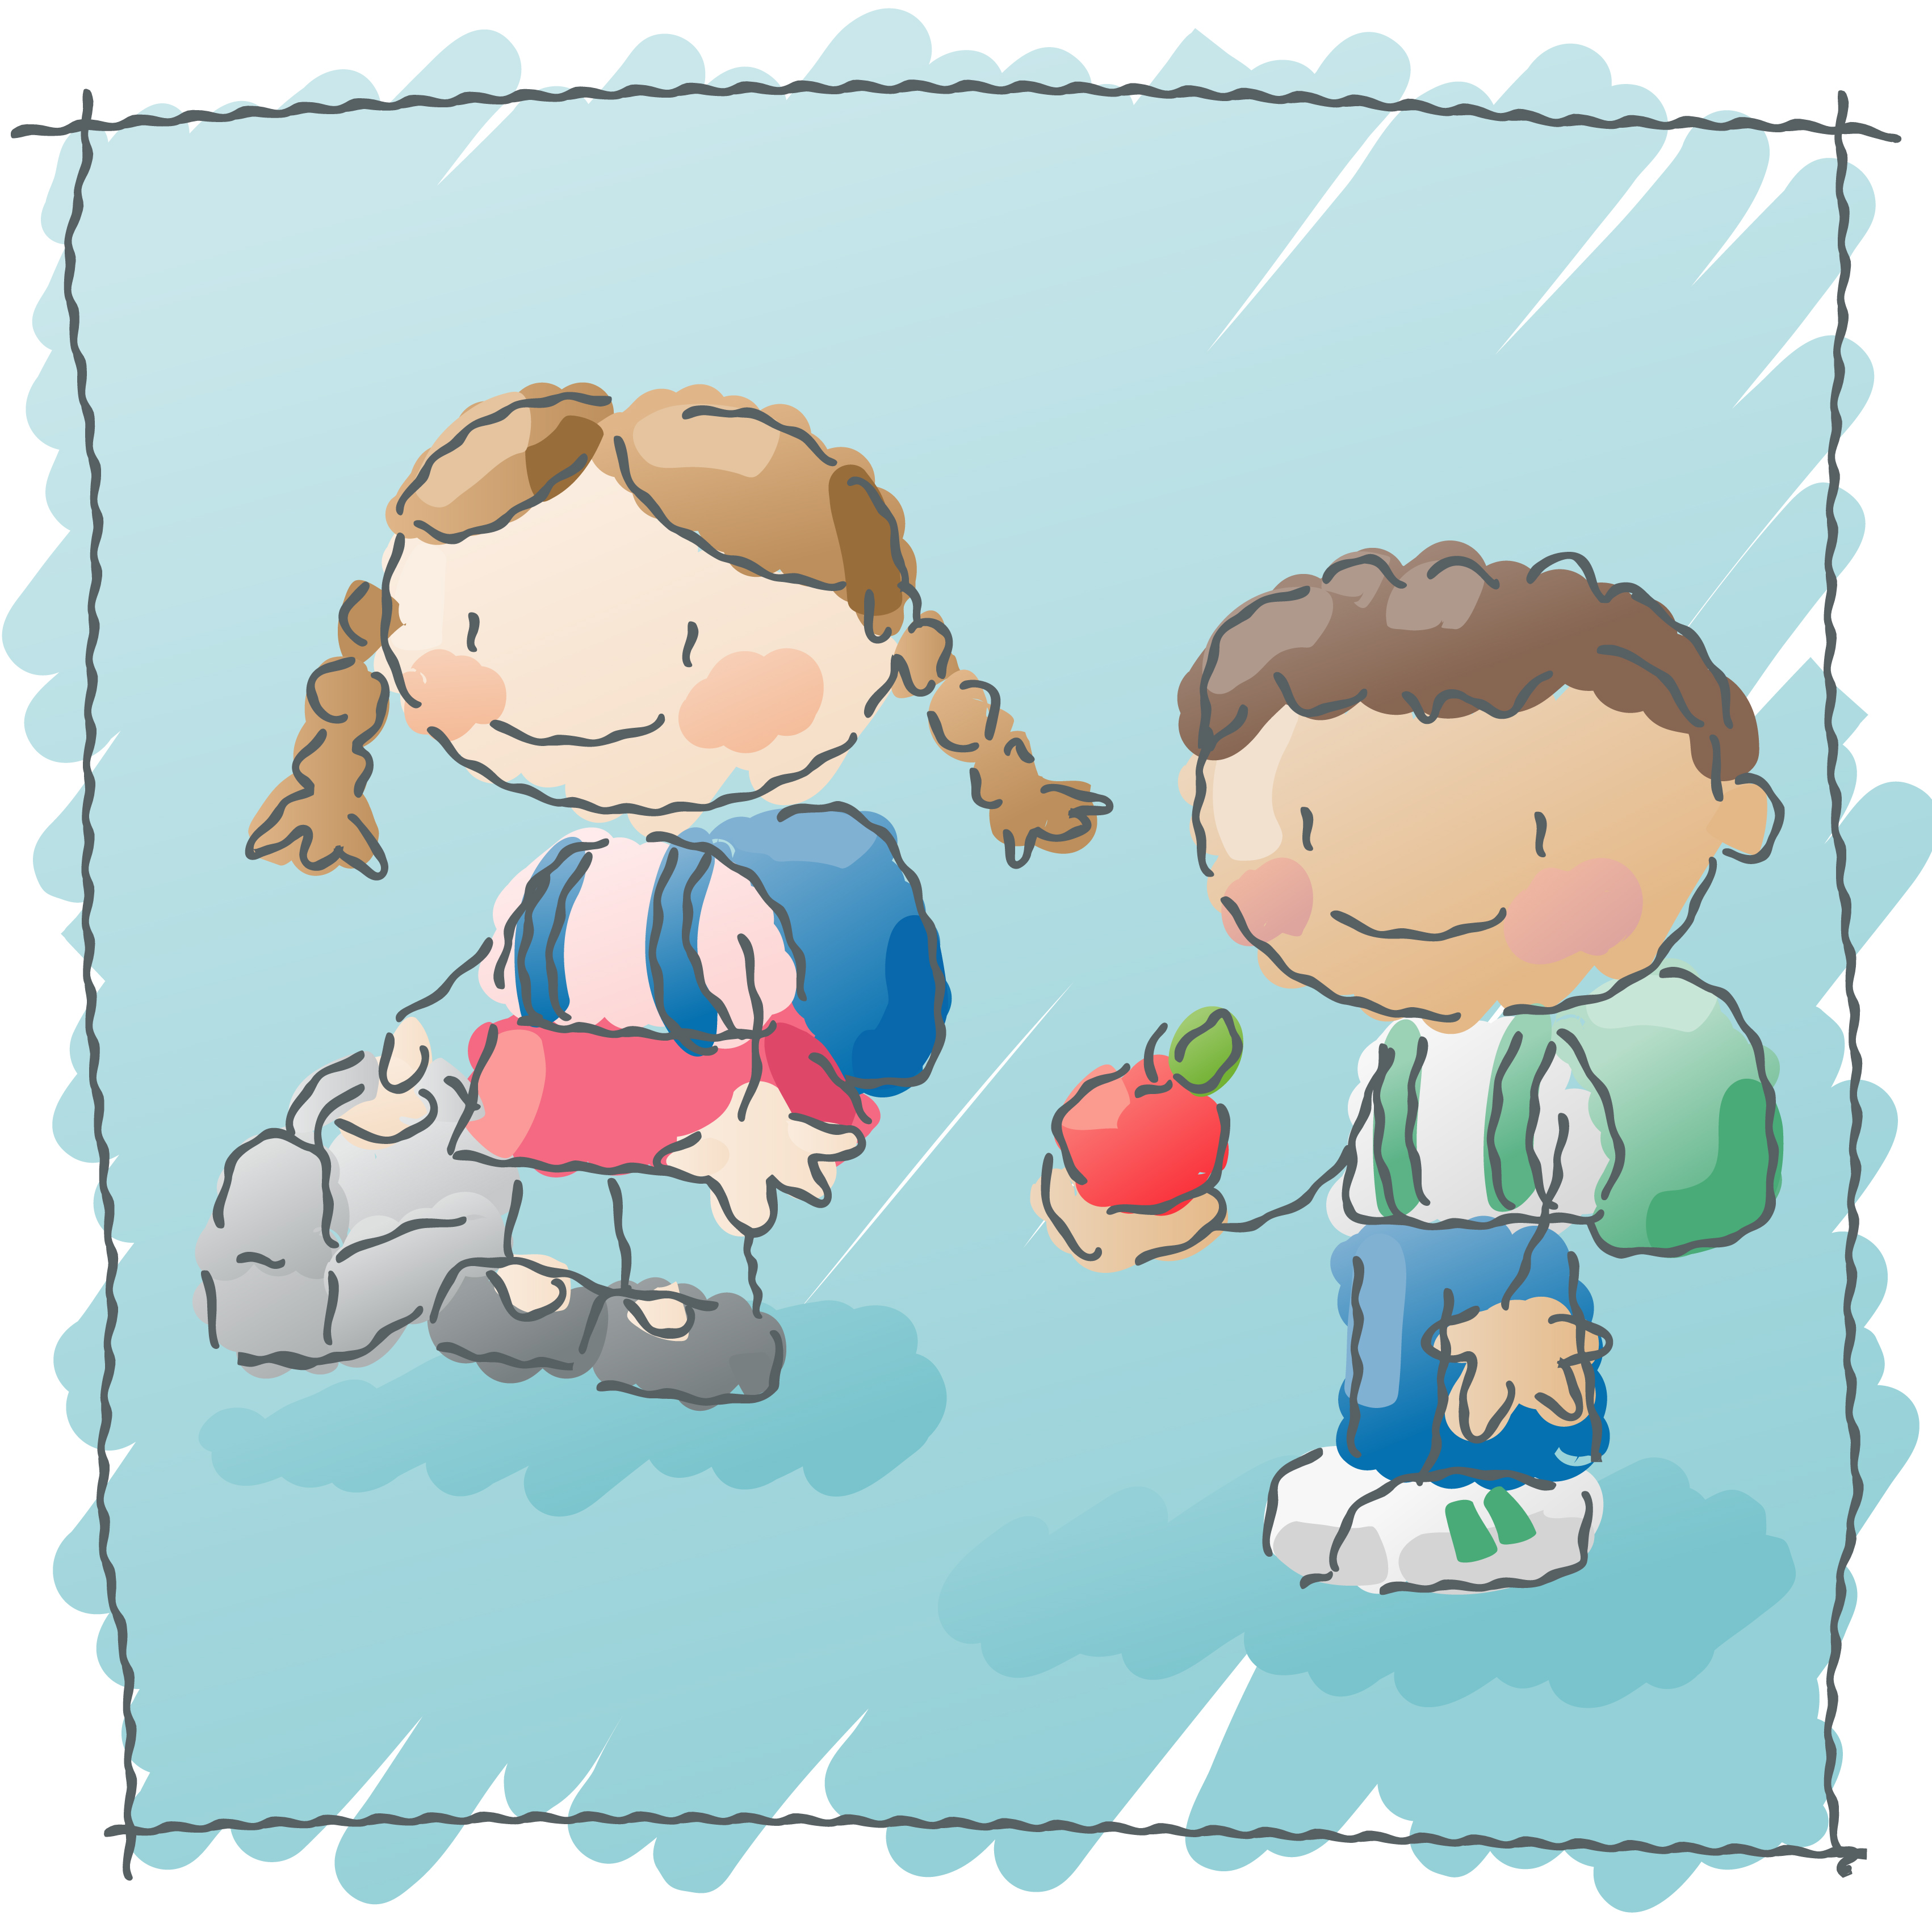
Step 1: Plan Your Calendar
The Challenge Schedule for each meet can be found on the WordMasters website under the RESOURCES tab. Plan your team’s schedule according to the following:
  Word List availability
  Challenge Test availability
  Score Reporting deadlines
  Results availability

Slide 4

Step 2: Practice Analogy Solving
WordMasters Analogies 101 Plus
  Eleven Analogies 101 Plus sets contain 30 analogies each that introduce various forms of analogical reasoning and use simple vocabulary suitable for all grade levels. An answer key is included with detailed rationale for both correct and incorrect answer choices.
  Analogies 101 Plus sets can be purchased online.
WordMasters Study Tool: Analogy Practice
A free download titled Analogy Practice (from
“Teacher Tools” under the RESOURCES tab)
has students build their own analogies to
better understand how to solve them.
A is to B
as
C is to D

Slide 5

Step 3: Download Meet #1 Words
To setup your team’s information and download Word Lists for each meet:
  Login to your WordMasters account
  Select “Manage Teams & Students” from your Dashboard
  Assign a Team Leader with contact information for each team
  Create individual student records
  Select “Download Materials” from your Dashboard
  Download the Word List for each enrolled team
  Distribute copies to your students
  Remember: The online Challenge Schedule lists the dates Word Lists are available for each meet.
Get
Ready!

Slide 6
Step 4: Prepare for Challenge Test
WordMasters Study Tools
Free printable documents for learning tools and games to help students practice their words for each meet. PDF files are found in “Teacher Tools” under the RESOURCES tab.
WordMasters Idea Gallery
Classroom strategies and teaching tools
submitted by Team Leaders. Look for them
under the RESOURCES tab. Don’t forget
to share your ideas, too!
Practice Time

Slide 7
Step 5: Download Meet #1 Test
To access your Challenge Tests for each meet:
  Login to your WordMasters account
  Select “Download Materials” from your Dashboard
  Download the Meet #1 Challenge Test and corresponding answer key for each registered team
  Remember: Each Challenge Test consists of 20 analogies. The suggested test time is 20 minutes. However, a strict time limit is not imposed.
Good Luck, Team!

Slide 8
Step 6: Submit Scores Online
To submit your team’s scores for each meet:
  Download the answer key from your Dashboard
  Score Challenge Tests
  Select “Submit Scores” from your Dashboard
  Enter student scores (No limit). You can create student records at anytime prior to the Challenge Meet in “Manage Teams & Students”
  The system will automatically calculate your
  team score (top 10 students)
  Remember: Since the online system is calculating the
  team score, test results must be reported by the
  deadline to be included in the competition results!
Submit Scores

Slide 9
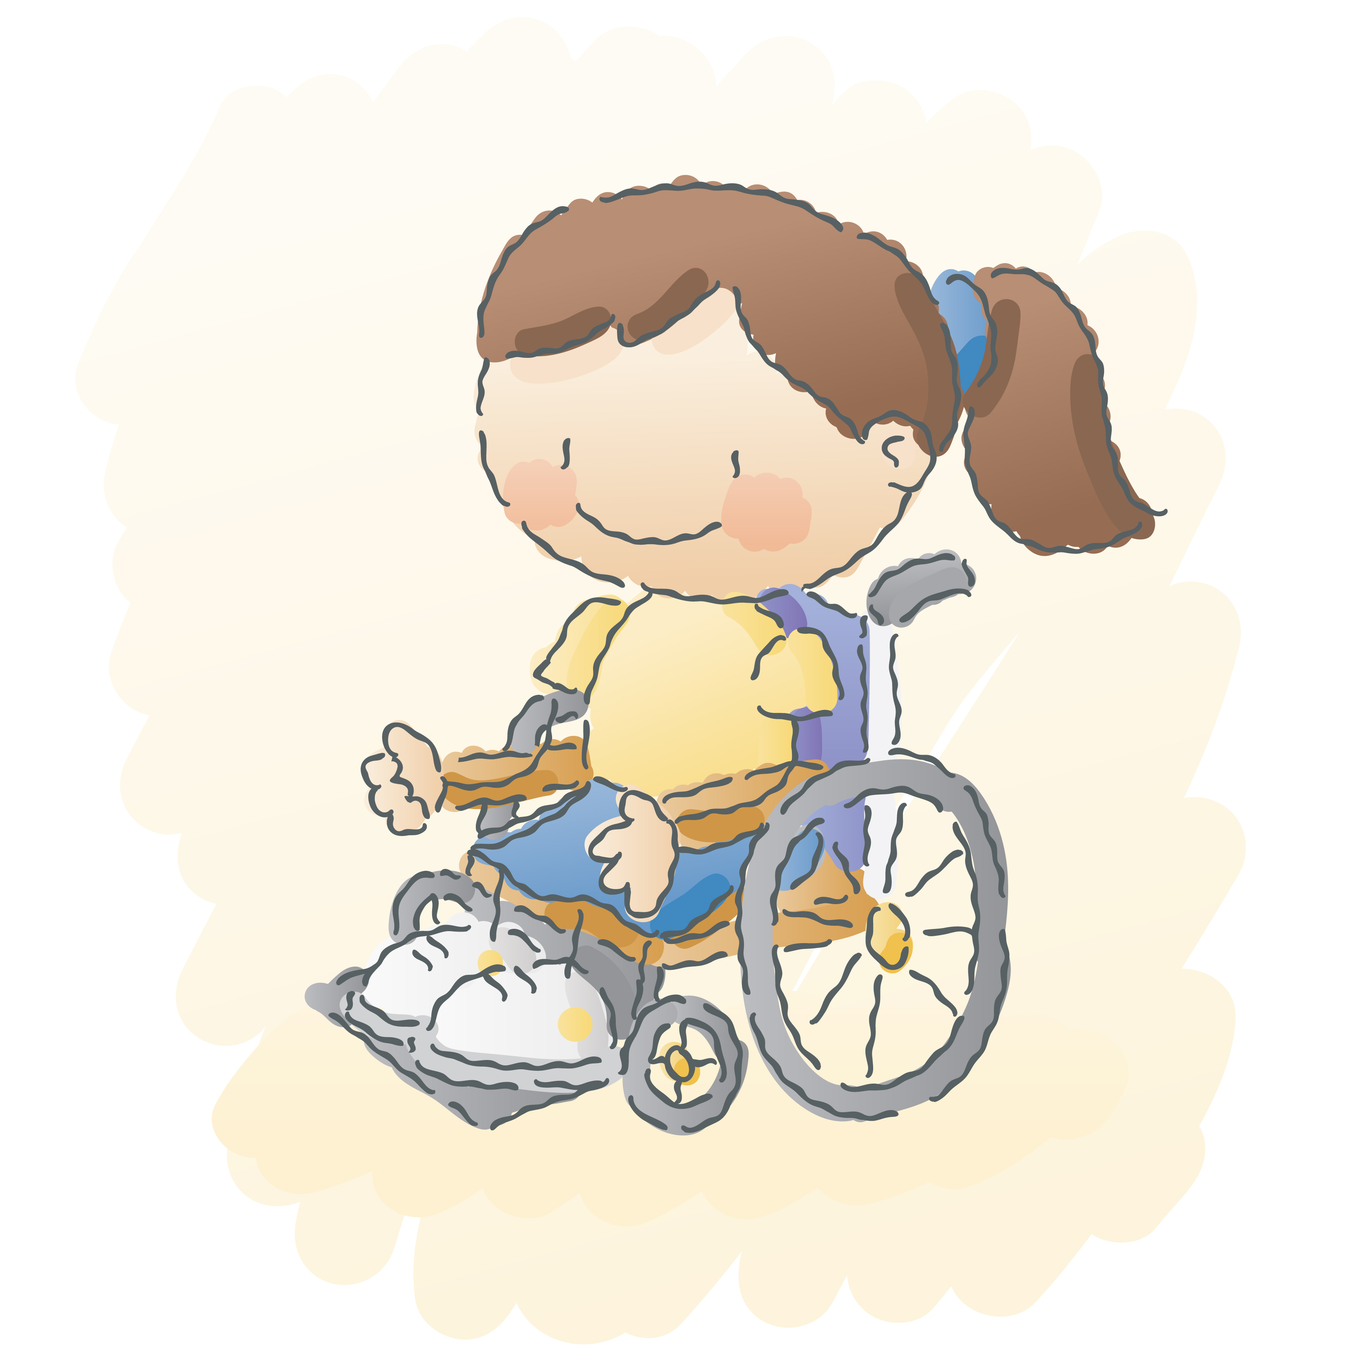
Step 7: Acknowledge Individual & Team Results
Check website postings after each meet for:
Top teams in each division
Students with perfect scores
Overall statistics related to meet results
Acknowledge students for their hard work and outstanding achievements. Challenge Tests are difficult.
They should feel proud of their efforts.
Remember: We’ll help you write a press release!
Find a template you can customize under “Teacher Tools”
to share with your local media and school communications.

Slide 10
Step 8: Repeat for Meet #2 and Meet #3
Repeat Steps 3-7 for each remaining Challenge Meet:
  Download Word Lists and Challenge Tests when available
  Submit scores prior to the Score Reporting Deadline
  Remember: Each successive meet will be somewhat more difficult than the one before it. Meet #2’s analogies will feature
  words from both of the first two Word Lists (50 words);
  Meet #3’s analogies will be based on all three
  Word Lists (75 words). Students should therefore
  save all their Word Lists and study materials.

Slide 11

Step 9: Celebrate Cumulative Results
After Meet #3, the system will automatically calculate cumulative individual and team scores.
Check web postings to see if any of your
students qualified for national recognition
or if your team ranked among the top ten
teams per division.

Slide 12

Step 10: Distribute Team Awards
Before Meet #3, we will mail the following for each enrolled team:
  1 Champion Medal-presented to the student of your choice (top scorer, most improved, best team player, etc). It’s up to you.
  10 Team Certificates to present to team members
  Remember: Extra medals, certificates and other WordMasters items (pencils, t-shirts and backpacks)
  can be purchased online to recognize additional team members.

Slide 13
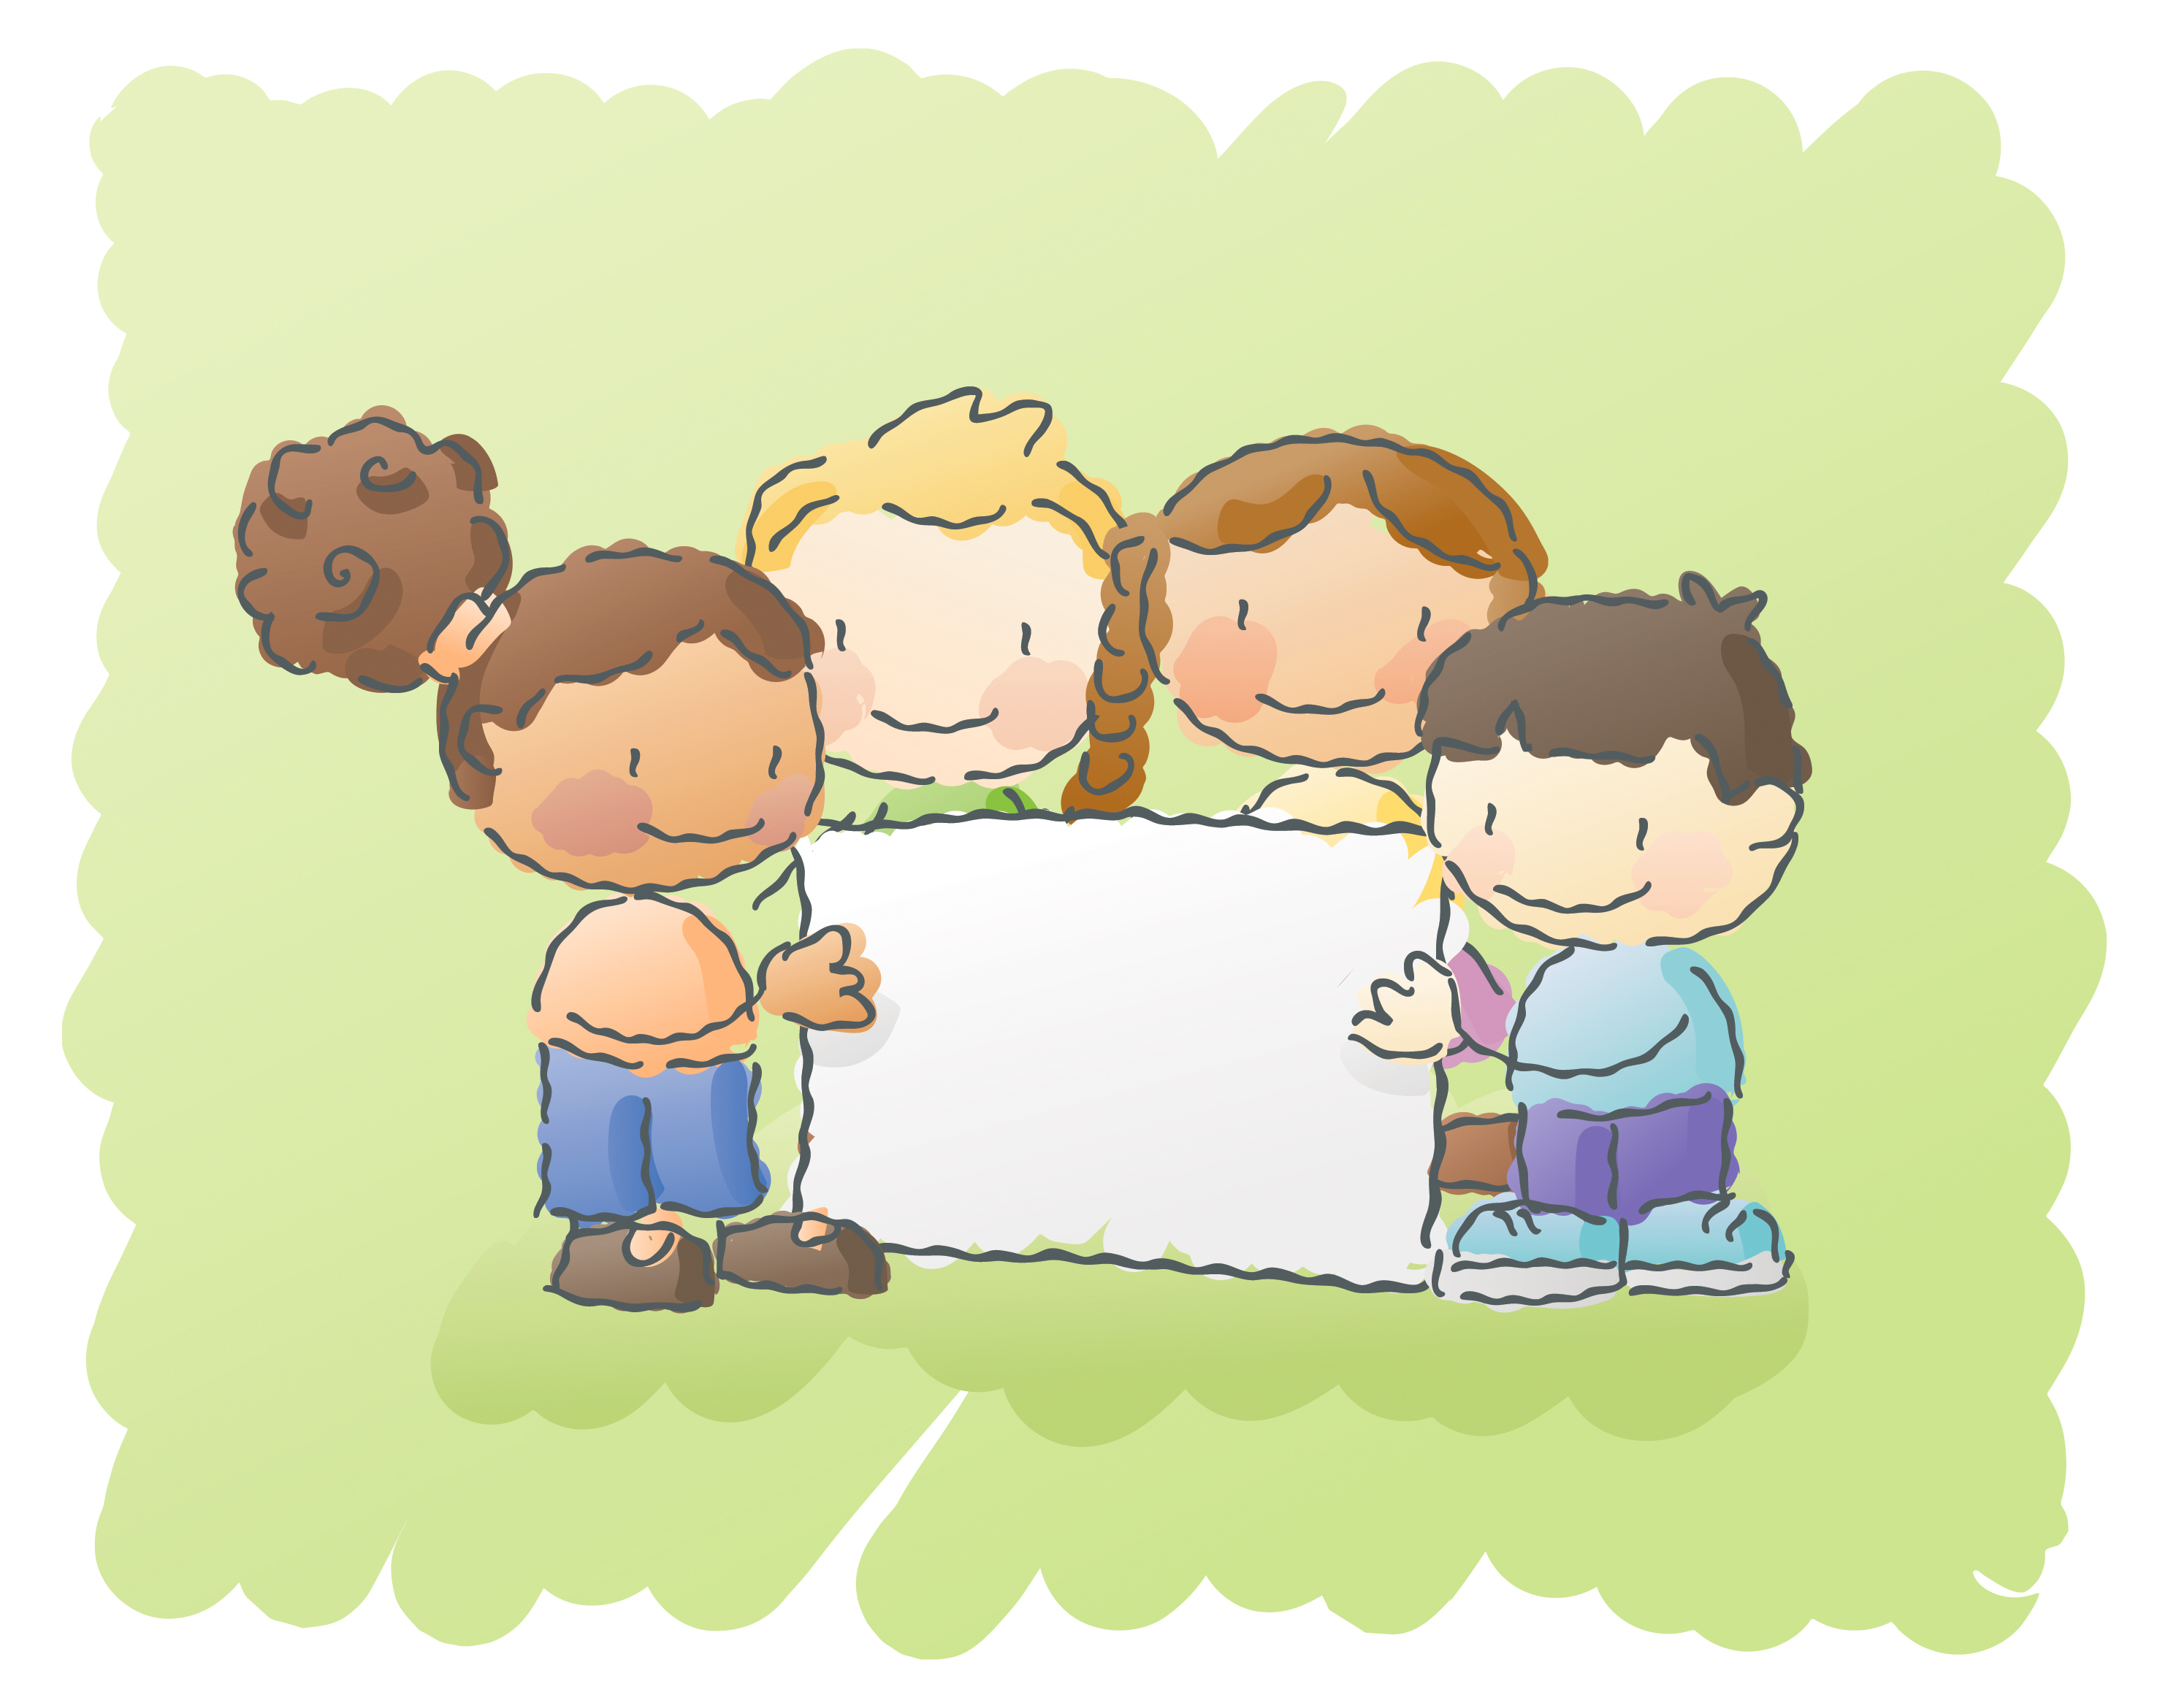
Re-enroll for the next WordMasters Challenge!
Enrollment opens each spring for the following school year.
Enroll before Word Lists are available October 1st.
We love
WordMasters!

Slide 14
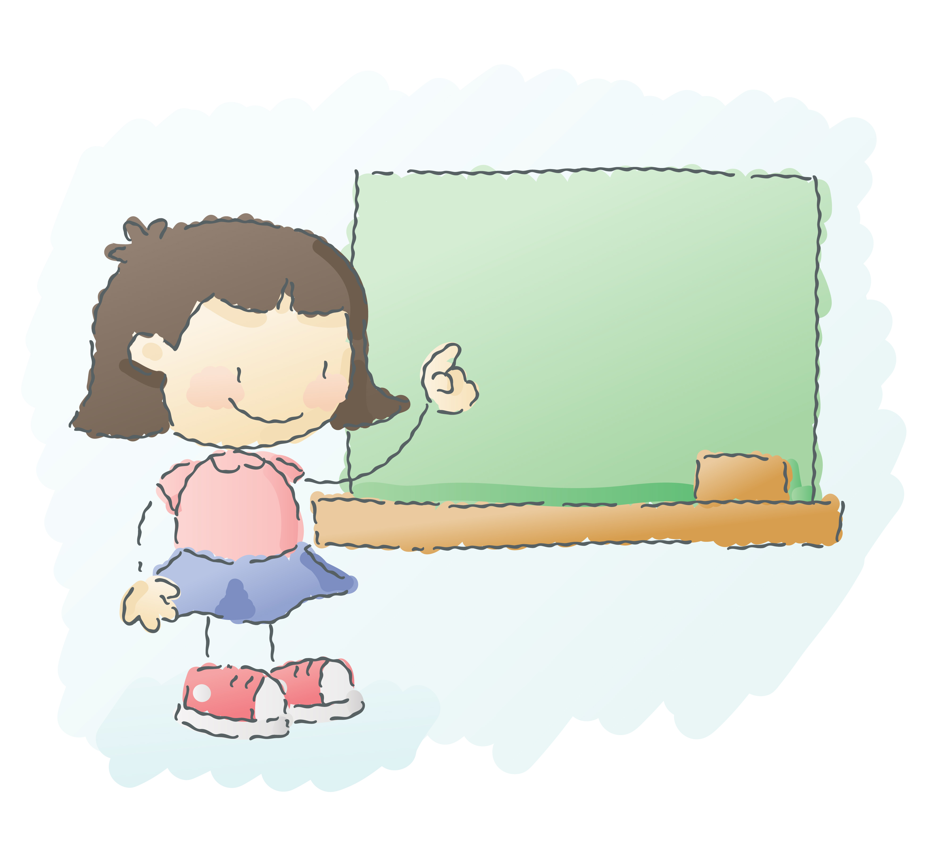




Stay Connected and Informed
Monthly newsletter
WordMasters Blog (twice a week on average)
Idea Gallery: Look for new ideas or share your own on our website.
Social Media
  Twitter & Facebook:
    Analogy of the Day: Test yourself or friends. The answer is posted the next day.
    Important reminders to keep you updated and prepared.
  Pinterest & YouTube:
    Share your fun ideas, resources and videos.
Share Your
Story!

Slide 15
Good Luck and Have Fun!
wordmasterschallenge.com | 888.385.5656

